Slide 1
Modeling Agility in Internet Of Things (IoT) Architecture
Prepared By:
Gurpreet Singh Matharu
Presented By:
Priyanka Upadhyay

Slide 2
INTRODUCTION
Internet of things is the next biggest revolution unfolding in the IT world which would transform the existing Internet into a fully integrated form of Internet. As the Internet revolutionized the connectivity among people, similarly IoT would deliver a smarter world through connectivity among things or objects. To realize the full vision of IoT, efficient provisioning of agile services is required. Internet of Things involves identifying things, sensing data, analyzing data and representing information taking cloud computing as its base.
Cloud computing is another emerging paradigm which can certainly contribute to the progress of IoT. Further, IoT can be defined as network of things representing active components of businesses, which can exchange data among each other by leveraging RFID technology and wireless sensor networks (WSNs).
The software industry is progressing at a rapid pace, resulting in increased software complexity and fuelling demand for quality services. Internet of Things is certainly the most trending technology, which simply involves interconnection of smart devices.
In this paper, we are modeling agility within the IoT architecture to provide best quality services to the business and technology. Transparency is the main enabler of agility which can be easily attained by leveraging the technology of IoT. IoT provides real time availability and data analysis, if modeled with agile perspective. In this paper, we propose an IoT model where we aim to provide the services with agility.

Slide 3
LITERATURE REVIEW
The research work conducted by Seppo Leminen [6] emphasises on the need for research into the emerging IoT models from the business perspective as these systems can provide efficient business models and improved business processes, besides slashing on risks and costs. Further, this study proposes a model to analyze differing IoT business models and concludes by providing useful suggestions to business model developers and researchers.
Dieter Uckelmann [4] puts forward a future architecture of Internet of Things, along with its key requirements and technical design for possible implementation. Further, the author concludes that the future Internet of Things will revolutionize the information flow in social, business and industrial settings.
In [7], the author explores an Internet of Things (IoT) approach to automation of manufacturing processes. The proposed IoT centered architecture focuses on providing agility and flexibility within the factory manufacturing settings. Further, reverse-engineering is conducted based on the agility requirements of the automation process.
The findings of the 7th Annual State of Agile Development Survey [11] conducted by Versionone.com in 2013 conclude that 92% of respondents believe that agile approach assists them in managing changing customer requirements, 87% of them agree that agile helps improve their team's productivity whereas 70% say that agile software approach accelerates the software development process.

Slide 4
GENERAL IoT ARCHITECTURE
The vision behind Internet of Things is to allow transformation of real-world physical objects into services available on the Internet disseminating information to improve business processes [9]. IoT involves machine-to-machine communications, machine-to-thing connectivity and thing-to-thing communications, where “things” refer to physical objects that provide some utility to applications and humans. Major technologies related to IoT include RFID for identification of things, sensors for sensing things and embedded systems for reading things.
The IoT is certainly the biggest revolution in the digital market and is expected to dominate the technology industry by around 2024. It would significantly contribute to quality, productivity, safety and information processing in business and organizations. Presently, an urgent need to adapt the IOT systems as per the business perspective is being realised as IoT offers efficient business models, improved business processes, and reduced costs [3].
The existing layered architecture of Internet of Things has been depicted in Fig. 1. Although the existing architecture suffers from several limitations, but business applications are most affected by lack of Agility for provisioning of services. This calls for introduction of agile strategies in IoT architecture. Here, Agile strategies refer to real-time management and execution capability, considering conflicting optimisation values for business parameters [9].

Slide 5
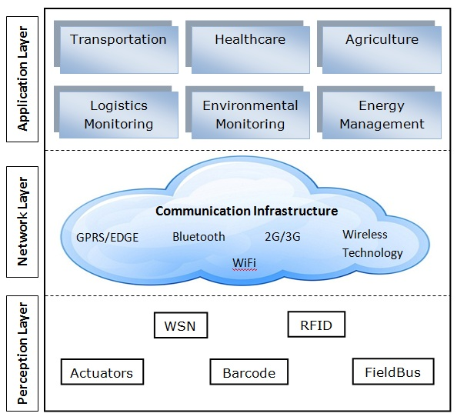
GENERAL IoT ARCHITECTURE
Fig. 1. General IoT Architecture

Slide 6
PROPOSED ARCHITECTURE FOR IoT
The simultaneous proliferation of Internet of Things and Agile Services gives birth to endless opportunities in the business market. In this paper, we propose an agile and flexible architecture for Internet of Things (IoT). The proposed model as shown in Fig. 2, focuses on adapting to dynamic customers’ needs along with flexible and agile delivery of services.
In the proposed architecture, we leverage the secure and agile database availability on the IOT cloud. Further, resources are being allocated in a more efficient, secure and agile manner. In this architecture, IOT takes cloud services as its base which may be software based, application based or platform based. The cloud centric agile IoT model ensures an end-to-end agile connectivity, thus providing more scalable storage and efficient computation.
The emerging Internet of Things is expected to impact majority of the application domains. There exist two perspectives for the vision of Internet of Things i.e. “Internet” centric and “thing” centric. In the proposed architecture depicted in Fig. 2, the primary focus is on the internet services where data is being contributed by the objects. The entire provisioning of services is monitored under the conditions of Agility by achieving quality services in the IOT environment [9].
The proposed cloud centric agile IoT model is a flexible and open architecture where the main focus lies on providing quality services to business users. The proposed architecture believes in modular approach and consists of three layers namely, the perception layer, the network layer and the application layer [10].

Slide 7
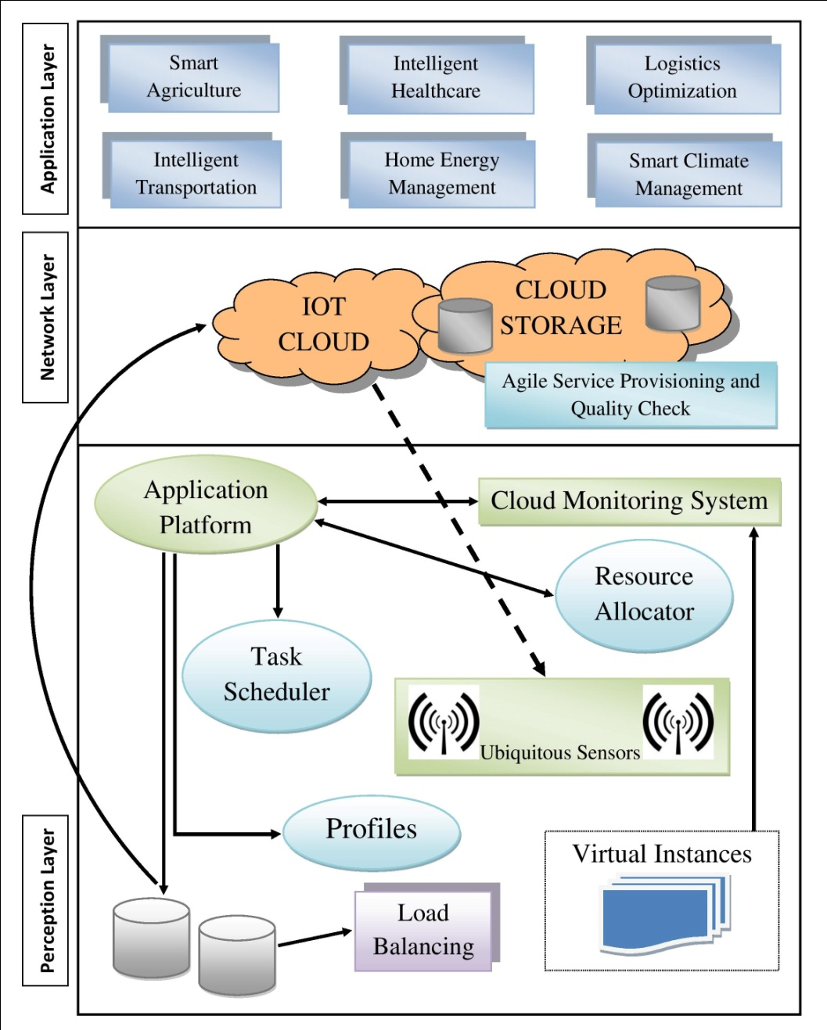
PROPOSED ARCHITECTURE FOR IoT
Fig. 2. Proposed Architecture for Modeling Agility in Cloud-Centric Internet of Things (IoT)

Slide 8
Perception Layer
In the perception layer, the sensors sense the data and transfer it to various objects, besides passing it on to the network layer which leverages the cloud services in an agile manner to immediately respond to the requests by passing on the correct message. To protect the server cloud from being overloaded, some devices need to be deployed that are capable of balancing the load at the data servers.
The application platform handles the allocation of resources whereas the cloud monitoring system keeps a track of all the resource allocation processes [8].
The resource and task schedulers are responsible for assigning a resource to a specific task in a business application on the basis of required quality of service (QoS) parameters.
Further, based on the data and computing requirements of each sensor, the application platform manages the dynamic resource provisioning while balancing the load and network resources.

Slide 9
Network Layer
In the network layer, sensors and servers across cloud platform store and process data as per user needs. The network layer needs to ensure that quality services are being delivered on time and the business requirements are being fulfilled with optimal performance. This necessitates the introduction of agility in the IoT architecture [1].
In order to realize maximum potential of cloud computing as ubiquitous sensing, cloud-centric model proves to be most viable at the network layer. The IoT cloud along with cloud storage, maintain data for all the business applications.

Slide 10
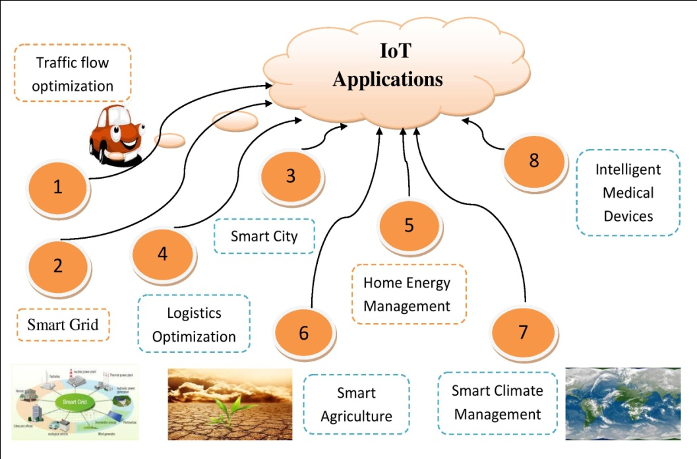
Application Layer
The idea of introducing agile services in Internet of Things would revolutionize the delivery of business applications. Hence, the introduction of agile services in IoT would result in significant improvement of existing business applications by ensuring higher customer satisfaction through delivery of quality services. As shown in fig.3, agility can be modeled in a wide array of application areas of Internet of Things including agriculture, transportation, logistics optimization, energy management, etc [2].
Fig. 3. IoT Applications

Slide 11
COMPARISON BETWEEN EXISTING AND PROPOSED MODEL
Parameters | Existing IoT Model | Agile IoT Cloud-Centric Model
Triggering | Simplified manual triggering: In the existing IoT model, the things across the network are connected among each other through the sensors. Eg. entry records, payments. | Automatic proximity triggering: In the proposed agile IoT model, businesses have a need to update triggered record automatically for any service requested through cloud centric platform.
Performance | Limited resources and performance issues: In the existing model, these limitations do not enable fulfillment of rising demands of the customers. | Highly supports better performance due to cloud services: The proposed model ensures better services that meet increasing availability and scalability in today’s business requirements.
Conformance to ITU-T standards | Absence of standards suggested by ITU-T: The existing model does not incorporate certain ITU-T standards required to ensure better quality services. | Presence of ITU-T standards: The proposed model adheres to the ITU-T standards to ensure delivery of high quality agile services to the customers.
Cost | High communication and components cost: Lack of cloud availability leads to deployment of sensors everywhere for receiving, transmitting and storing all information which eventually adds up to the costs. | Low communication and components cost: Cloud streamlines the communication between various sensor components which can be accessed globally irrespective of location resulting into lower communication costs.
Quality checks | No quality checks: The existing model does not have specific quality check standards. | Regular agile service provisioning checks: This ensures that the functioning of all tasks conforms to the standards.
Table 1. Comparison between existing IoT model and proposed agile IoT cloud-centric model

Slide 12
FUTURE SCOPE
In this paper, we are modeling the Internet of Things (IoT) architecture with agile perspective to meet complex and ever-evolving requirements of growing business organizations where delivery of quality services as per available resources and time, is the prime objective. The paper puts forward an architecture model for IoT, focusing on delivery of agile services.
The proposed architecture, besides inculcating the inherent benefits of leveraging the cloud services, offers several advantages such as modular and scalable architecture, agile provisioning of services, dynamic resource allocation required to meet present-day complex business needs.
Further, the paper compares the existing IoT model with the proposed agile IoT cloud-centric model. Today’s business settings demand agility to respond to ever-changing requirements, and IoT can provide endless applications required to sustain and grow businesses.
Currently, the researches based on development of agile IoT model are still in infancy and therefore, more research work needs to be conducted to enable the efficient provisioning of agile services in IoT applications. Therefore, businesses must view the IoT as an opportunity to build on the cloud platforms, enabling them to provide agile services with responsiveness to dynamic business requirements.

Slide 13
REFERENCES
[1] Khattak AM, Pervez Z, Sarkar AMJ, Lee YK (2010) Service Level Semantic Interoperability. Paper presented at the 10th IEEE/IPSJ International Symposium on Applications and the Internet, Seoul, 19-23 July 2010
[2] Singh D, Tripathi G, Jara AJ (2014) A survey of Internet-of-Things: Future Vision, architecture, challenges and services. Paper presented at the 2014 IEEE World Forum on Internet of Things (WF-IoT), Seoul, 6-8 March 2014
[3] Aggarwal C, Ashish N, Sheth A (2013) The Internet of Things: A Survey from The Data-Centric Perspective. In: Aggarwal CC (ed) Managing and Mining Sensor Data, Springer US
[4] Uckelmann D, Isenberg MA, Teucke M, Halfar H, Scholz-Reiter B (2010) An integrative approach on Autonomous Control and the Internet of Things. In: Ranasinghe D, Sheng Q, Zeadally S (eds) Unique Radio Innovation for the 21st Century: Building Scalable and Global
[5] Gubbi J, Buyya R, Marusic S, Palaniswami M (2013) Internet of Things (IoT): A Vision, Architectural Elements, and Future Directions. Future Generation Computer Systems, 29(7):1645-1660, ISSN: 0167-739X, Elsevier Science, Amsterdam, The Netherlands
[6] Leminen S, Westerlund M, Rajahonka M (2012) Towards IOT Ecosystems and Business Models. In: Andreev S, Balandin S, Koucheryavy Y (eds) Internet of Things, Smart Spaces, and Next Generation Networking. Lecture Notes in Computer Science, Springer Berlin Heidelberg
[7] Houyou AM, Huth HP, Trsek H, Kloukinas C, Rotondi D (2012) Agile Manufacturing General challenges and an IoT@Work perspective. Paper presented at the 17th IEEE International Conference on Emerging Technologies and Factory Automation (ETFA), Krakow, 17-21 Sept 2012
[8] Kulkarni RV, Förster A, Venayagamoorthy GK (2011) Computational Intelligence in Wireless Sensor Networks: A Survey. IEEE Communications Surveys & Tutorials 13:68–96
[9] Ruiz-de-Garibay J, Campo T, Alvarez M (2011) Flexible and agile architecture for Internet of Things gadgets. Paper presented at the 2011 IEEE International Conference on RFID-Technologies and Applications (RFID-TA), Sitges, 15-16 Sept 2011
[10] Lopez TS, Ranasinghe DC, Harrison M, McFarlane D (2012) Adding sense to the Internet of Things An architecture framework for Smart Objective systems. Pervasive Ubiquitous Computing 16:261–278
[11] Versionone (2013) 8th Annual State of Agile Survey. http://www.versionone.com/pdf/2013-state-of-agile-survey.pdf

Slide 14
THANK YOU !

